Slide 1







SQL PROJECT
DIGITAL MEDIA STORE ANALYSIS

Slide 2


OBJECTIVE
The purpose of the analysis is to gain insights into the operations and performance of the digital media store modeled by the Chinook database. By analyzing sales data, customer behavior, and product performance, we aim to identify trends, patterns, and opportunities for optimization. This analysis will help stakeholders make informed decisions to improve sales, enhance customer satisfaction, and drive business growth.

Slide 3


LEVEL OF QUERIES
EASY-
Includes: Select, Group By, Order By , Limit, Desc/Asc
ADVANCE- Includes: CTE(Common Table Expression)
MODERATE- Includes: Joins, Order By, Group By, Limits.

Slide 4


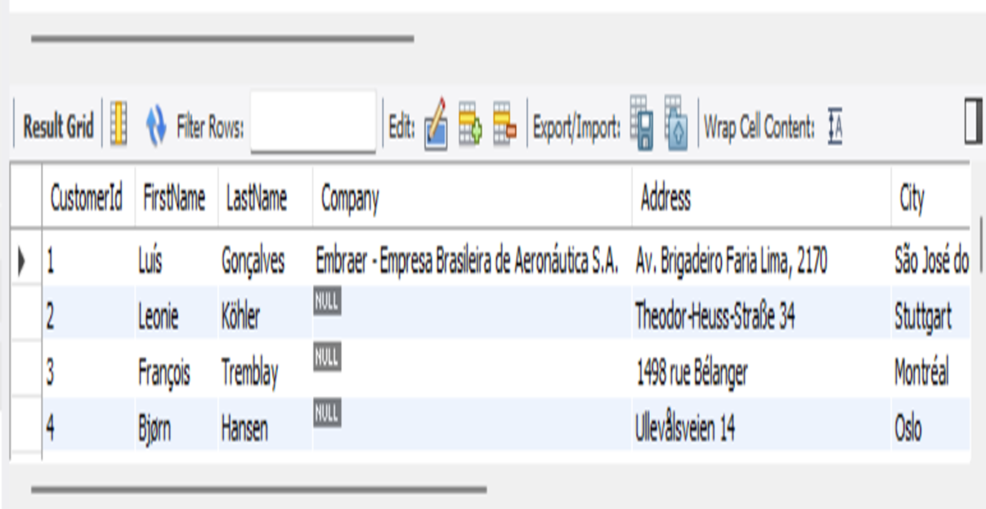


EASY
SELECT * FROM customer;
Select all columns from the customers table:
Output

Slide 5
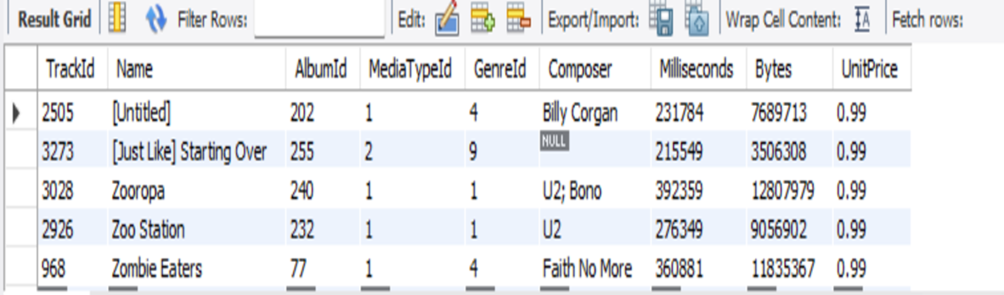
EASY
SELECT * FROM track
ORDER BY Name DESC
LIMIT 5;
Select the first 5 rows from the tracks table, ordered by track name in descending order:
Output

Slide 6
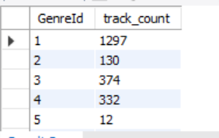
EASY
SELECT GenreId, COUNT(*) AS track_count FROM track
GROUP BY GenreId
ORDER BY GenreId ASC;
Count the number of tracks in each genre, ordered by genre name in ascending order:
Output

Slide 7
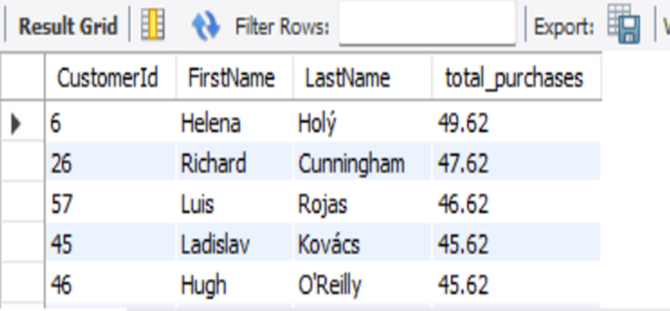
MODERATE
SELECT c.CustomerId, c.FirstName, c.LastName, SUM(i.Total) AS total_purchases
FROM customer c
INNER JOIN invoice i ON c.CustomerId = i.CustomerId
GROUP BY c.CustomerId, c.FirstName, c.LastName
ORDER BY total_purchases DESC;
List customers who have made purchases, along with their total purchases amount, ordered by total amount in descending order
Output

Slide 8
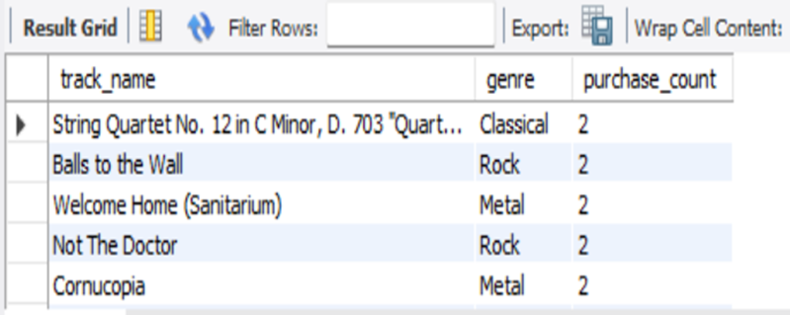
MODERATE
SELECT t.Name AS track_name, g.Name AS genre, COUNT(*) AS purchase_count
FROM track t
INNER JOIN invoiceline i ON t.TrackId = i.TrackId
INNER JOIN genre g ON t.GenreId = g.GenreId
GROUP BY t.TrackId, t.Name, g.Name
ORDER BY purchase_count DESC
LIMIT 10;
Show the top 10 tracks by the number of times they have been purchased, along with their genre, ordered by number of purchases in descending order
Output

Slide 9
MODERATE
SELECT c.FirstName, c.LastName, c.Country, SUM(i.total) AS total_spent
FROM customer c
INNER JOIN invoice i ON c.CustomerId = i.CustomerId
WHERE c.Country = 'USA'
GROUP BY c.FirstName, c.LastName, c.Country
ORDER BY total_spent DESC
LIMIT 1;
Find the customer from the USA who has spent the most on purchases
Output

Slide 10
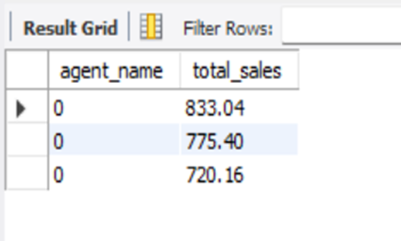
ADVANCE
WITH agent_sales AS (
SELECT e.EmployeeId, e.FirstName || ' ' || e.LastName AS agent_name, SUM(i.Total) AS total_sales
FROM employee e
INNER JOIN customer c ON e.EmployeeId = c.SupportRepId
INNER JOIN invoice i ON c.CustomerId = i.CustomerId
GROUP BY e.employeeId, agent_name
)
SELECT agent_name, total_sales
FROM agent_sales
ORDER BY total_sales DESC;
Calculate the total revenue generated by each employee in the Sales Support Agent role, ordered by total revenue in descending order
Output

Slide 11
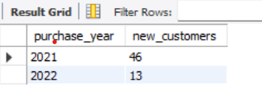
ADVANCE
WITH first_purchase_year AS (
SELECT customer_id, MIN(invoice_date) AS first_purchase
FROM invoices
GROUP BY customer_id
)
SELECT YEAR(first_purchase) AS purchase_year, COUNT(*) AS new_customers
FROM first_purchase_year
GROUP BY purchase_year
ORDER BY purchase_year ASC;
Find the number of customers who made their first purchase in each year, ordered by year in ascending order
Output

Slide 12
THANK YOU!

